Slide 1
Learning Objective
I will be able to express large numbers in scientific notation and standard form
Success Criteria
At the end of the lesson, I will be able to:
convert between scientific notation and standard form (decimal form);
evaluate product and quotients of numbers in scientific notation using index laws;
use scientific notation to solve practical problems involving significantly large/small numbers; and
define a significant figure, including the laws for the ‘significant 0’.

Slide 2
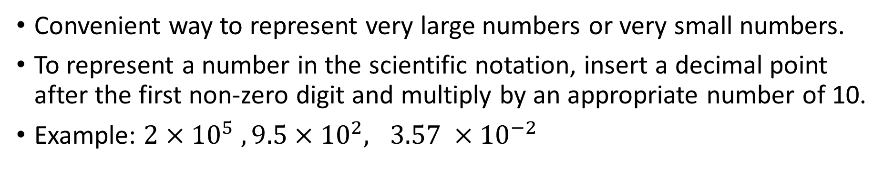
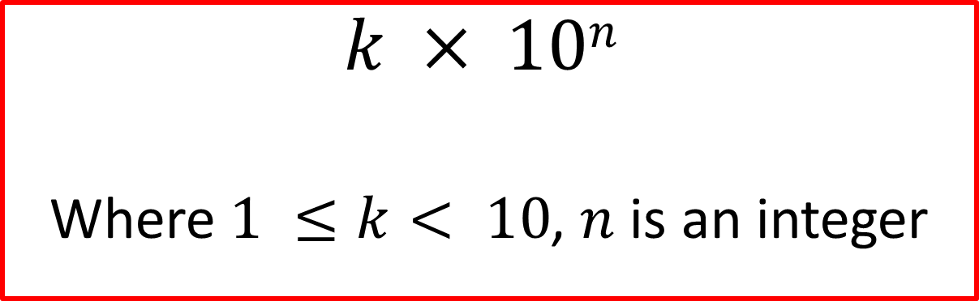
Scientific notation (Standard form)
Concept Development
$$k × 10n$$
Where $1 ≤k< 10$, $n$ is an integer
Convenient way to represent very large numbers or very small numbers.
To represent a number in the scientific notation, insert a decimal point after the first non-zero digit and multiply by an appropriate number of 10.
Example: $2×{10}^{5} , 9.5×{10}^{2}, 3.57 ×{10}^{−2}$

Slide 3
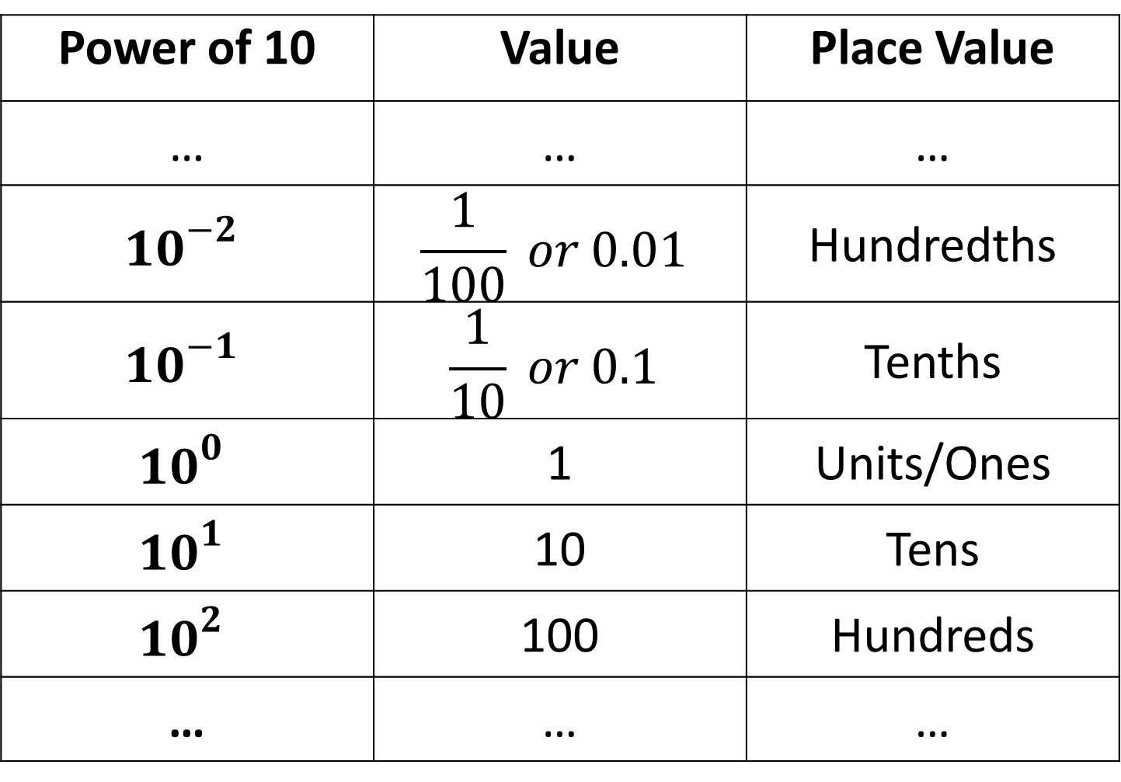
Concept Development
Power of 10 | Value | Place Value
… | … | …
$${10}^{−2}$$ | $$\frac{1}{100} or 0.01$$ | Hundredths
$${10}^{−1}$$ | $$\frac{1}{10} or 0.1$$ | Tenths
$${10}^{0}$$ | 1 | Units/Ones
$${10}^{1}$$ | 10 | Tens
$${10}^{2}$$ | 100 | Hundreds
… | … | …

Slide 4
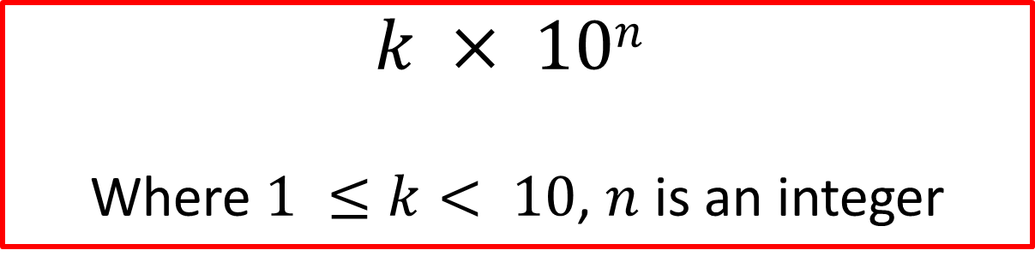
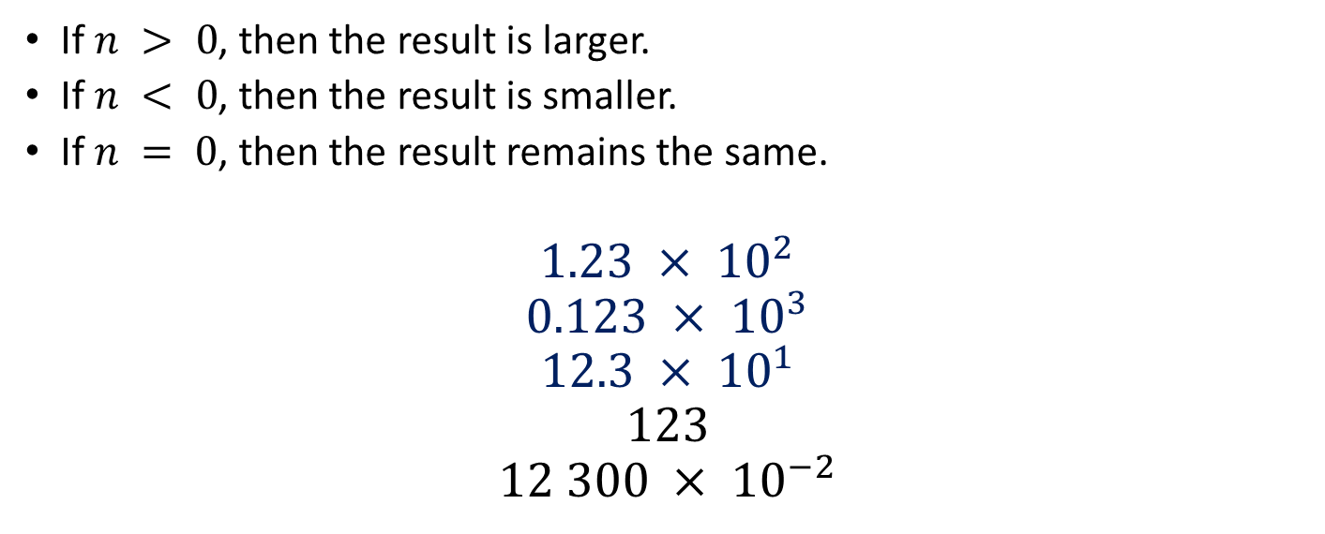
Concept Development
$$k × 10n$$
Where $1 ≤k< 10$, $n$ is an integer
If $n > 0$, then the result is larger.
If $n < 0$, then the result is smaller.
If $n = 0$, then the result remains the same.
$$1.23 × {10}^{2}$$
$$0.123 × {10}^{3}$$
$$12.3 × {10}^{1}$$
$$123$$
$$12 300 × {10}^{−2}$$

Slide 5




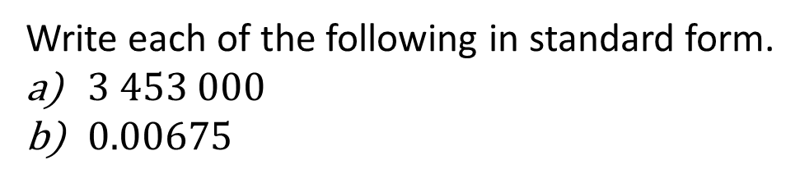
Guided Practice
Write each of the following in standard form.
$3 453 000$
$0.00675$
a) $3453000$
b) $0.00675$
$$=3.454×{10}^{6}$$
$$=6.75×{10}^{−3}$$

Slide 6
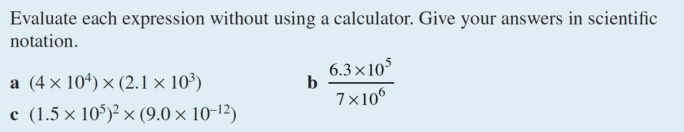
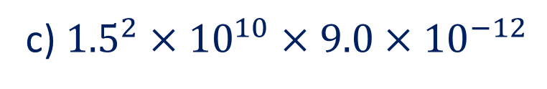
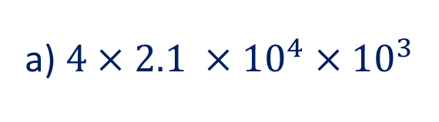

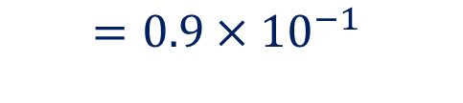





Guided Practice
a) $4×2.1 ×{10}^{4}×{10}^{3}$
c) ${1.5}^{2}×{10}^{10}×9.0×{10}^{−12}$
$$=8.4 ×{10}^{7}$$
$$=2.25×9.0×{10}^{10−12}$$
b) $\frac{6.3}{7}×{10}^{5−6}$
$$=20.25×{10}^{−2}$$
$$=0.9×{10}^{−1}$$
$$=2.025×{10}^{−1}$$
$$=9×{10}^{−2}$$

Slide 7

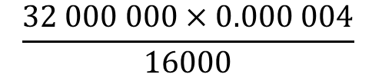



Guided Practice
Find fully the value of
$$\frac{32 000 000×0.000 004}{16000}$$
$$\frac{32 000 000×0.000 004}{16000}$$
$$=\frac{3.2×{10}^{7}×4×{10}^{−6}}{1.6×{10}^{4}}$$
$$=\frac{12.8×{10}^{1}}{1.6×{10}^{4}}$$
$$=\frac{128×{10}^{0}}{16×{10}^{3}}$$
$$=8×{10}^{−3}$$
$$=0.008$$

Slide 8
Significant figure
Concept Development
The length of a rope is 20.5 m
Doris’ height is 158 cm
Actual length between 20.45m and 20.55m (not inclusive)
Highlight the level of inaccuracy and uncertainties.
Actual height between 157.5 cm and 158.5 cm (not inclusive)

Slide 9
Concept Development
0.00006025 4 significant figures
6025 4 significant figures
60.250 5 significant figures
6 025 000 4 significant figures
60 250. 5 significant figures
6.025 x 10⁴ 4 significant figures
0 before the first number is not to be counted (‘leading zeros’)
0 between two numbers is to be counted (‘trapped zeros’)
0 at the end is to be counted after the decimal (‘trailing zeros’)
0’s at the end are not counted (‘trailing zeros’)
0’s at the end are counted because of the decimal
The power of 10 in scientific notation is not significant

Slide 10





How many significant figures?
Guided Practice
800
8.0 $×$ 10²
8 $×$ 10²
8.00 $×$ 10²
$$1$$
$$2$$
$$1$$
$$3$$

Slide 11
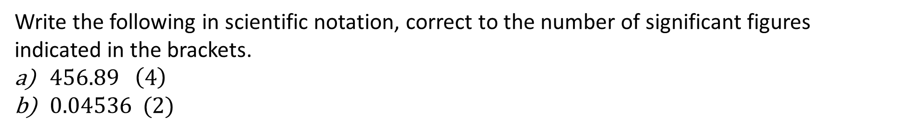


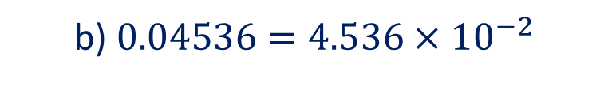

Guided Practice
Write the following in scientific notation, correct to the number of significant figures indicated in the brackets.
$456.89 \left(4\right)$
$0.04536 (2)$
a) $456.89=4.5689×{10}^{2}$
$=4.569×{10}^{2}$ (4s.f.)
b) $0.04536=4.536×{10}^{−2}$
$=4.5×{10}^{−2}$ (2.s.f)

Slide 12
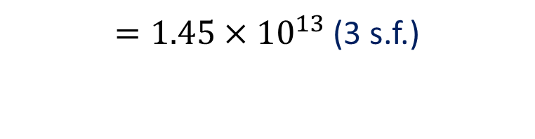


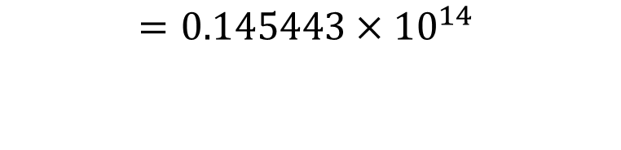

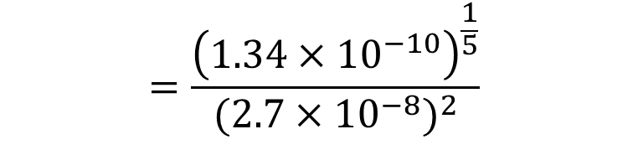
Guided Practice
Evaluate $\frac{\sqrt[5]{a}}{b^{2}} if a=1.34×{10}^{−10} and b=2.7×{10}^{−8}$, correct to 3 significant figures.
$$\frac{\sqrt[5]{1.34×{10}^{−10}}}{{(2.7×{10}^{−8})}^{2}}$$
$$=\frac{{\left(1.34×{10}^{−10}\right)}^{\frac{1}{5}}}{{(2.7×{10}^{−8})}^{2}}$$
$$=\frac{{1.34}^{\frac{1}{5}}×{10}^{−2}}{{2.7}^{2}×{10}^{−16}}$$
$$=0.145443×{10}^{14}$$
$$=1.45443×{10}^{13}$$
$=1.45×{10}^{13}$ (3 s.f.)

Slide 13
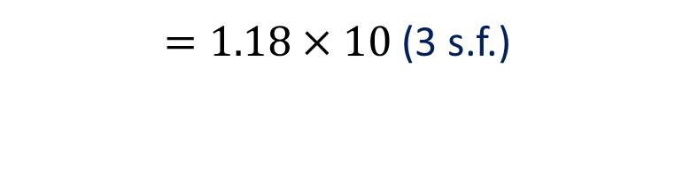
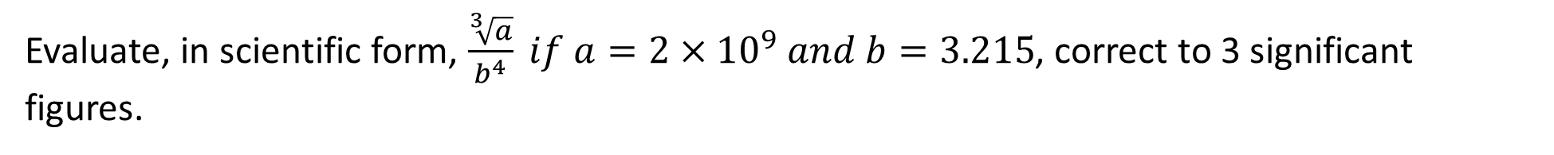





Guided Practice
Evaluate, in scientific form, $\frac{\sqrt[3]{a}}{b^{4}} if a=2×{10}^{9} and b=3.215$, correct to 3 significant figures.
$$\frac{\sqrt[3]{2×{10}^{9}}}{{(3.215)}^{4}}$$
$$=\frac{{\left(2×{10}^{9}\right)}^{\frac{1}{3}}}{{(3.215)}^{4}}$$
$$=\frac{2^{\frac{1}{3}}×{10}^{3}}{{(3.215)}^{4}}$$
$$=0.01179×{10}^{3}$$
$$=1.179×{10}^{1}$$
$=1.18×10$ (3 s.f.)

Slide 14
Operations with significant figures – adding and subtracting
Concept Development
When ADDING AND SUBTRACTING with significant figures:
Count the number of significant figures in the decimal portion ONLY of each number in the problem
Add or subtract in the normal fashion
Your final answer is the LEAST number of significant figures in the decimal portion in any number in the problem.
For example, with the sum 4.435 + 1.9348,
4.435+1.9348
=6.3698
=6.370 (3 d.p.)

Slide 15
Operations with significant figures – multiplying and dividing
Concept Development
When MULTIPLYING AND DIVIDING with significant figures, the final value must only have as many significant figures as the original value with the least significant figures. (You are now looking at the entire number, not just the decimal portion)
For example, with the product 2.05×132×1.7
The least number of significant figures is 2. So, the answer must be given to 2 significant figures.
2.05×132×1.7
=460.02
=460 (2 s.f.)

Slide 16
Independent Practice
Complete Ex 14C

